Slide 1
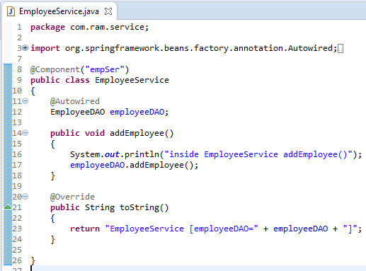
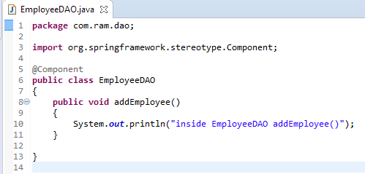
Custom auto scan component name
Annotate with @Component to indicate this class is an auto scan component.
By default, Spring will lower case the first character of the component – from ‘EmployeeService’ to ‘employeeService’. And you can retrieve this component with name ‘employeeService’.
To create a custom name for component, we can put custom name like this

Slide 2
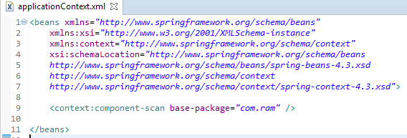
Custom auto scan component name
Add this “context:component” in bean configuration file, it means, enable auto scanning feature in Spring.
The base-package is indicate where are your components stored, Spring will scan this folder and create the bean (annotated with @Component) and register it in Spring container.

Slide 3
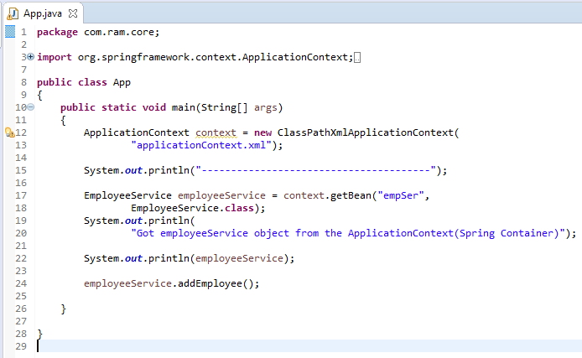
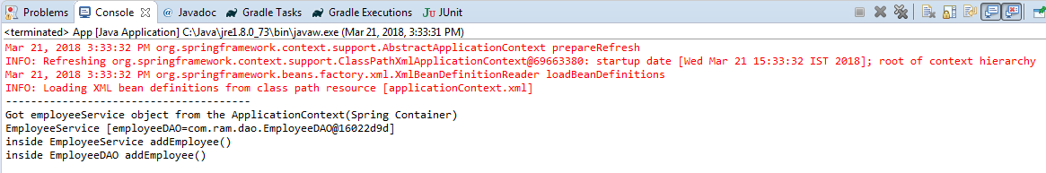
Custom auto scan component name

